Slide 1
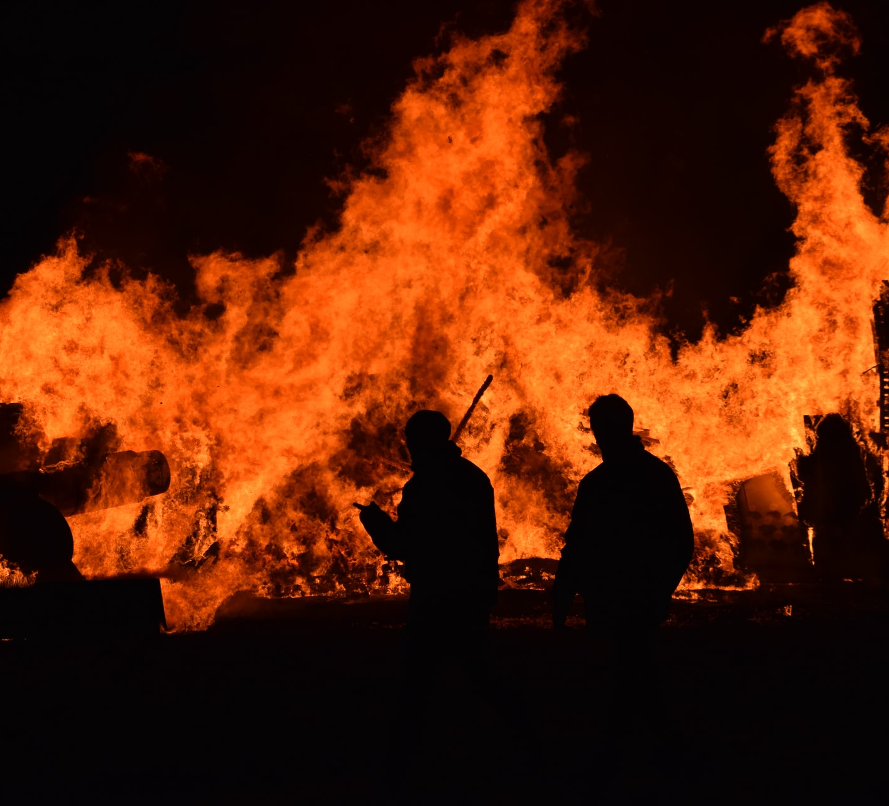
California Wildfire Dashboard Project
Team 7

Slide 2

Key Questions
Have California wildfires becomes more frequent?
Have California wildfires become larger?
Have California wildfires become more destructive?.

Slide 3
The Data
List data sources/datasets w/ a few notes
Historical California Wildfire data is not easily accessible.

Slide 4











Solution Architecture
NodeJS API serving up query endpoints
All ETL done on PostgreSQL

Slide 5
Quick Demo
California Wildfire Dashboard

Slide 6
Findings
Have California wildfires becomes more frequent?
Have California wildfires become larger?
Have California wildfires become more destructive?.

Slide 7
Limitations
Data Availability
NIFC (National Interagency Fire Center
Data management & hosting was completely changed in 2020
Data & Time

